Slide 1
Spring Cloud Circuit Breaker – Resilience4J

Slide 2
Resilience4J
Resilience4j is a lightweight fault tolerance library designed for functional programming.
Resilience4j provides higher-order functions (decorators) to enhance any functional interface, lambda expression or method reference with a Circuit Breaker, Rate Limiter, Retry or Bulkhead.
It can stack more than one decorator on any functional interface, lambda expression or method reference.

Slide 3
Resilience4J – Features:
Circuit Breaker
Retry
Bulkhead
RateLimiting
TimeLimiting

Slide 4
Resilience4J – Circuit Breaker
Circuit Breaker is a resilience pattern that helps to prevent cascading failures in distributed systems. It acts as a safety mechanism that isolates failing components to prevent further errors from propagating.
The CircuitBreaker uses a sliding window to store and aggregate the outcome of calls. It can choose between a count-based sliding window and a time-based sliding window.
The count-based sliding window aggregrates the outcome of the last N calls. The time-based sliding window aggregrates the outcome of the calls of the last N seconds.

Slide 5
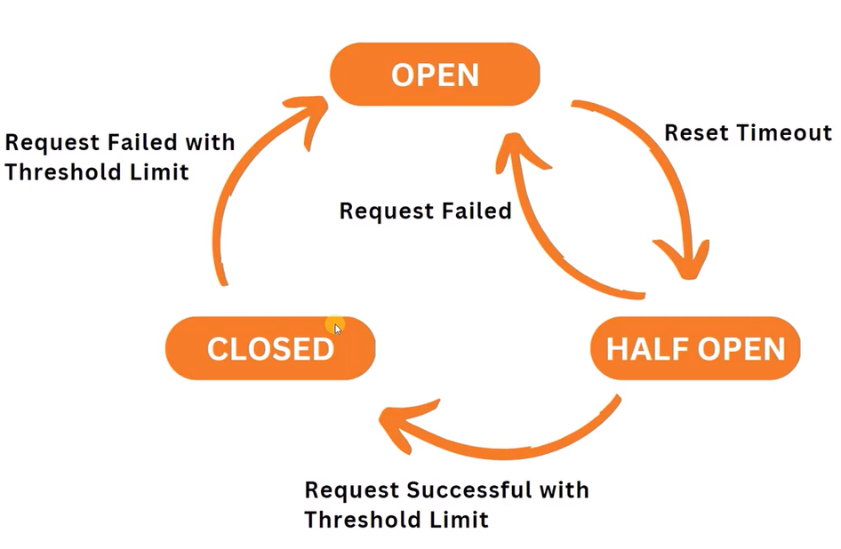
Spring Cloud Circuit Breaker

Slide 6
Resilience4J – Circuit Breaker
Open State:
When a component fails a certain number of times within a specified window, the circuit breaker transitions to the open state.
In this state, all subsequent requests are immediately rejected without attempting to call the component.
Closed State:
If the component successfully recovers from the failure, the circuit breaker transitions to the closed state.
In this state, requests are allowed to proceed normally.

Slide 7
Resilience4J – Circuit Breaker
Half-Open State:
After a specified wait duration, the circuit breaker enters the half-open state. In this state, a limited number of requests are allowed to pass through.
If these requests are successful, the circuit breaker transitions to the closed state. Otherwise, it remains in the open state.
Fallback Mechanism:
It allows to configure a fallback mechanism to be executed when the circuit breaker is open.
This allows you to provide a graceful degradation of service or return a default response.

Slide 8
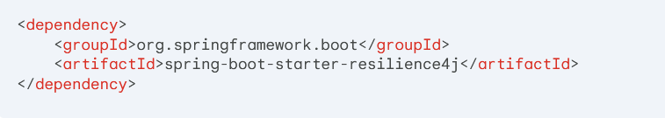
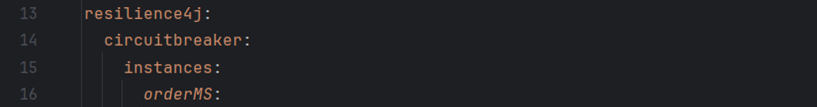
Resilience4J – Circuit Breaker
Properties and Configuration:
Configuration
In Controller :
In Properties:
@CircuitBreaker(name = "orderMS", fallbackMethod = "fallbackMethod")

Slide 9
Resilience4J – Circuit Breaker
Properties and Configuration:
Parameter | Description | Default Value
name | Unique identifier for the circuit breaker. | default
failureRateThreshold | Percentage of failed calls within a sliding window that triggers the open state. | 50%
waitDuration | Duration the circuit breaker remains open after it trips. | 60 seconds
slidingWindowSize | Size of the sliding window used to calculate the failure rate. | 10
recordFailurePredicate | Predicate used to determine if a call should be considered a failure. | Default predicate based on exceptions

Slide 10
Resilience4J – Circuit Breaker
Properties and Configuration:
Parameter | Description | Default Value
slowCallDurationThreshold | Threshold for considering a call as slow. | null (not enabled by default)
automaticTransitionToHalfOpen | Whether the circuit breaker should automatically transition to the half-open state after the wait duration. | TRUE
halfOpenWindow | Size of the half-open window. | 10
callCombineFunction | Function to combine multiple calls into a single result. | null (no combination by default)
slowCallRateThreshold | Threshold for the rate of slow calls. | null (not enabled by default)

Slide 11
Resilience4J – Circuit Breaker
Collecting metrics in Resilience4J Circuit Breaker
Parameter | Description
success | Number of successful calls.
failure | Number of failed calls.
slowCall | Number of calls that exceeded the slow call duration threshold.
notPermitted | Number of calls that were not permitted due to the circuit breaker being open.
error | Number of calls that resulted in an error.

Slide 12
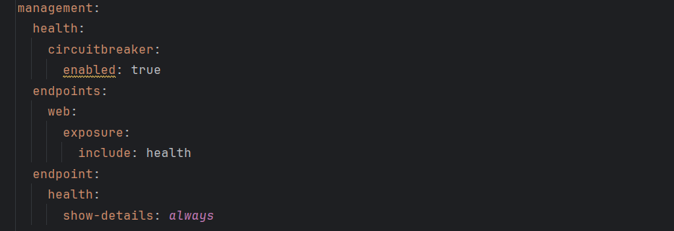
Resilience4J – Circuit Breaker
Collecting metrics in Resilience4J Circuit Breaker
Configuring metrics in Resilience4J Circuit Breaker

Slide 13
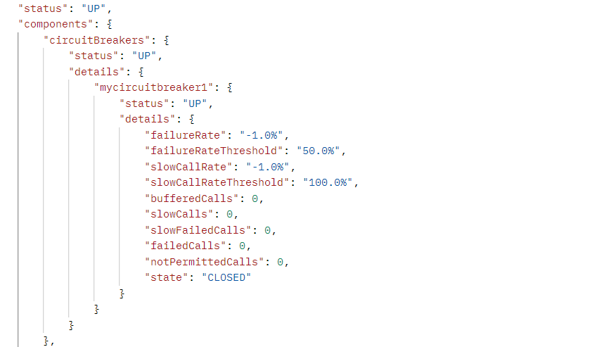
Resilience4J – Circuit Breaker
Collecting metrics in Resilience4J Circuit Breaker

Slide 14
Resilience4J – Bulkhead
Bulkhead is a resilience pattern that isolates groups of resources to prevent failures from affecting the entire application.
In Resilience4J, it's used to limit the number of concurrent calls to a specific resource or group of resources.
Parameter | Description | Default Value
maxConcurrentCalls | Maximum number of concurrent calls allowed. | 10
maxWaitDuration | Maximum duration a call can wait for a slot before rejecting. | Duration.ZERO (no waiting)
fallbackStrategy | Strategy to use when the bulkhead is full. | REJECT (reject the call)

Slide 15
Resilience4J – RateLimiting
Resilience4J Ratelimiter is a powerful tool for controlling the rate of incoming requests to a service or resource.
It helps prevent overload and ensures that resources are not overwhelmed by excessive traffic.
Parameter | Description | Default Value
name | Unique identifier for the ratelimiter. | default
limit | Maximum number of requests allowed within the specified time window. | 10
timeout | Time window for rate limiting. | Duration.ofSeconds(1)
limitRefreshPeriod | Period at which the limit is refreshed. | Duration.ofSeconds(1)
rejectionStrategy | Strategy to use when the rate limit is exceeded. | REJECT

Slide 16
Resilience4J – Retry
The Retry pattern is a resilience mechanism that automatically retries a failed operation a specified number of times before giving up.
This can be useful for handling transient failures, such as network timeouts or database connection issues.
Parameter | Description | Default Value
maxAttempts | Maximum number of retries | 3
Interval/wait-duration | Time to wait between retries | 5 seconds
waitStrategy | Strategy for calculating wait time | FixedWaitStrategy
ignoreExceptions | List of exceptions to ignore | Empty list

Slide 17
Resilience4J vs Spring Retry
Both Resilience4J and Spring Retry are powerful tools for implementing retry and circuit breaker patterns in Java applications.
However, they have distinct approaches and features.
Feature | Resilience4J | Spring Retry
Resilience Patterns | Circuit Breaker, Retry, Ratelimiter, Bulkhead | Retry
Configuration | Declarative annotations or programmatic configuration | Annotation-based or programmatic configuration
Metrics | Provides built-in metrics | Limited metrics

Slide 18

Lab: Working with Spring Cloud Circuit Breaker
Lab Guide:
https://spring.io/guides/gs/cloud-circuit-breaker

